Slide 1
Economic impacts
Methods for estimating total welfare impact
Benefit transfer
Results and caveats
Climate v weather
Social cost of carbon
Distribution of impacts

Slide 2
Lectures
Science
Scenarios & emission reduction options
Costs of emission reduction
Instruments for emission reduction
Impacts of climate change & adaptation
Economic impacts of climate change
Climate and development
Optimal emission reduction
Discounting, uncertainty, equity
International environmental agreements

Slide 3
Economic impacts
Methods for estimating total welfare impact
Benefit transfer
Results and caveats
Climate v weather
Social cost of carbon
Distribution of impacts

Slide 4
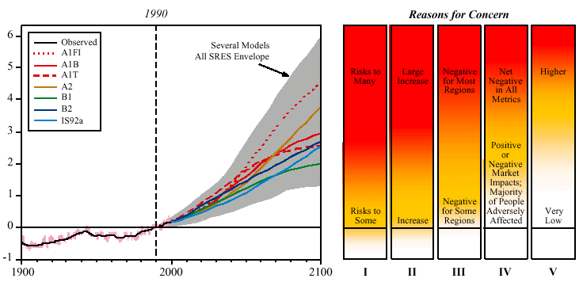
Global mean warming ºC
Year
I Risks to Unique and Threatened Systems
II Risks from Extreme Climate Events
III Distribution of Impacts
IV Aggregate Impacts
V Risks from Future Large-Scale Discontinuities
Source: IPCC 2001

Slide 6

Methods
Enumerative method
Quantify impact, estimate price, add up
Computable general equilibrium
Quantify impact, shock model, estimate welfare change
Statistical method
Estimate relationship between activity and climate over space, assume it holds over time
Estimate relationship between well-being and climate
Elicitation method
Ask experts

Slide 7
Monetary Valuation
The aim is to express a welfare loss in an equivalent income loss
Revealed preferences
Travel cost
Hedonic pricing
Stated preferences
Contingent valuation
Contingent choice
Each method has its drawbacks, but stated preferences suffer from a range of biases, including unfamiliarity and manipulation

Slide 8
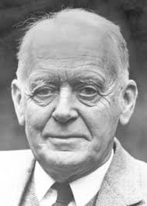



WTP v WTAC
Willingness to pay, or equivalent variation, is the maximum amount you would be willing to pay to secure a price fall
Willingness to accept compensation, or compensating variation, is the minimum amount you would be willing to accept to forego a price fall
Willig (1976) showed that
This is because of the income effect
He also showed that
This is because of substitution
Result carries over to quantities
$$EV<ΔCS<CV$$
$$EV≈ΔCS≈CV$$

Slide 10
WTP and WTAC -2
Willingness to pay and willingness to accept compensation are different, because
the budget constraint is different
voluntary and involuntary risks are different
people attach value to the status quo
Relevant for climate because
willingness to pay for a better climate for our children and grandchildren
Our children’s and grandchildren’s willingness to accept compensation for us imposing a worse climate on them

Slide 11
Economic impacts
Methods for estimating total welfare impact
Benefit transfer
Results and caveats
Climate v weather
Social cost of carbon
Distribution of impacts

Slide 12
Benefit transfer
Valuation is difficult and expensive
Therefore, estimated values are extrapolated (benefit transfer) from one place to the next and from one case to the next
Important for climate as
We need total impact, not just some case studies
We need future, yet-to-observed impact
As values are highly context-specific, this introduces all sorts of uncertainties, which are not well-understood

Slide 13
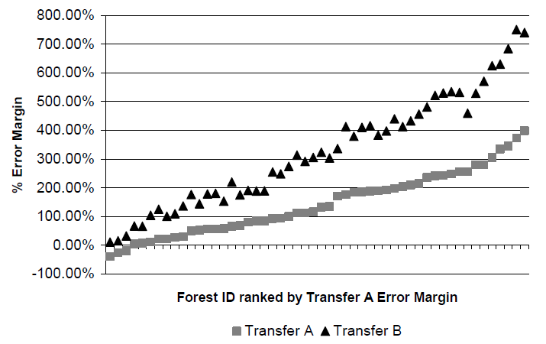

Slide 14
Area | Error (%)
Sport fishing | 5-40
 | 5-15
Water quality improvements | 4-34
 | 1-75
Water-based recreation | -
 | 1-475
Water quality improvements | 25-45
 | 18-41
Saltwater fishing | 1-34
 | -
White water rafting | 24-56
 | 6-228
Biodiversity on agricultural land | 27-36
 | 22-44

Slide 15
Economic impacts
Methods for estimating total welfare impact
Benefit transfer
Results and caveats
Climate v weather
Social cost of carbon
Distribution of impacts

Slide 16
Economic impacts
Methods for estimating total welfare impact
Benefit transfer
Results and caveats
Climate v weather
Social cost of carbon
Distribution of impacts

Slide 17
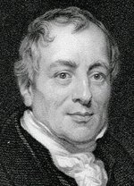
Methods
Enumerative method
Quantify impact, estimate price, add up
Computable general equilibrium
Quantify impact, shock model, estimate welfare change
Statistical method
Estimate relationship between activity and climate over space, assume it holds over time
Estimate relationship between well-being and climate
Elicitation method
Ask experts

Slide 18
Economic impacts
Methods for estimating total welfare impact
Benefit transfer
Results and caveats
Climate v weather
Social cost of carbon
Distribution of impacts

Slide 20
Caveats
Incomplete assessment
Interactions between impacts
Stylised adaptation
Low probability, high impact
Indirect impacts
Large-scale changes

Slide 22
Economic impacts
Methods for estimating total welfare impact
Benefit transfer
Results and caveats
Climate v weather
Social cost of carbon
Distribution of impacts

Slide 23
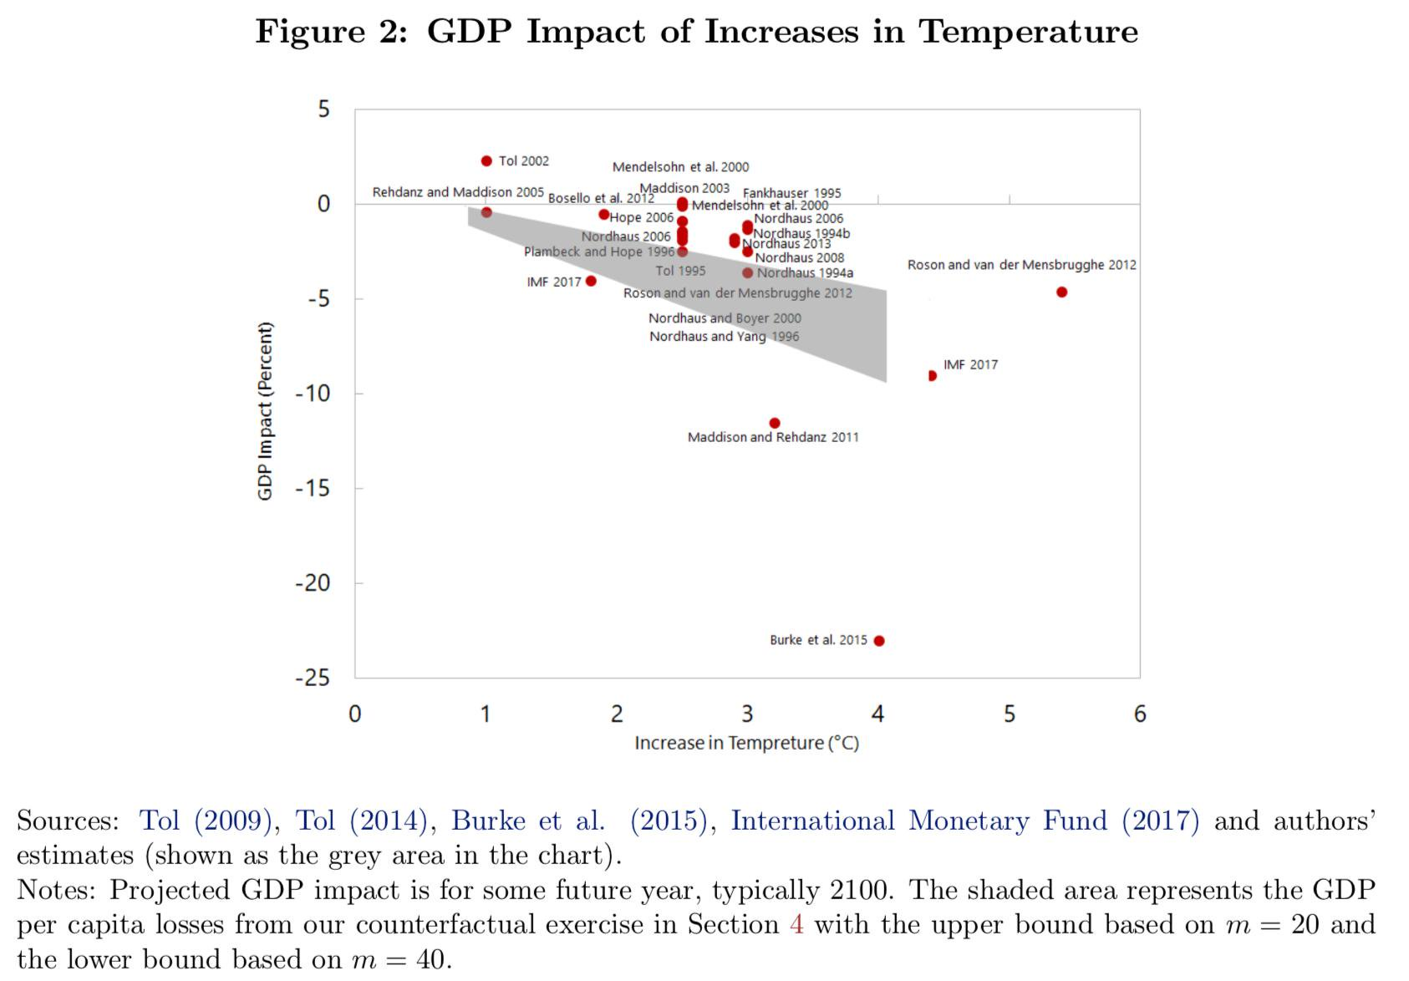

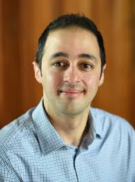

Slide 24
Weather v climate
Estimating the impact of climate change is difficult because it changes slowly over time, while differences over space are confounded with all sorts of everything
Estimating the impact of weather is easy because data is plentiful and shocks are random (or rather orthogonal to the economy)
Extrapolating from weather shocks to climate change is problematic

Slide 25
Weather v climate
Extrapolate from weather shocks to climate change?
Climate is what you expect, weather is what you get
Weather throws the punches, climate trains the boxer
Weather is your mood, climate is your personality
If you don't like the weather, wait. If you don't like the climate, move.
Adaptation is different
Put up your umbrella, buy an umbrella
Close the flood gates, build flood gates
Short-term vs long-term elasticity
Fixed vs malleable capital stock, technology
Expectations matter too

Slide 26
Economic impacts
Methods for estimating total welfare impact
Benefit transfer
Results and caveats
Climate v weather
Social cost of carbon
Distribution of impacts

Slide 27
Marginal Damage Costs
The marginal damage cost is the damage done by an additional tonne of CO2 emitted
It is the change in the net present value of the monetised impacts, normalised by the change in emissions
The marginal damage cost is the Pigou tax – it says how much we should spend on climate policy, by how much we should raise energy prices
It is a normative concept; it tells us what to do, given our values

Slide 28
Social cost of carbon
27 estimates of the total impact of climate change, 2789 estimates of its first partial derivative
Proliferation of estimates because
Total impact used to calibrate different impact curves
Different scenarios
Different climate models
Different carbon cycle models
Total impact hides regional, sectoral detail
Different views on how to aggregate over time, space and risk

Slide 29
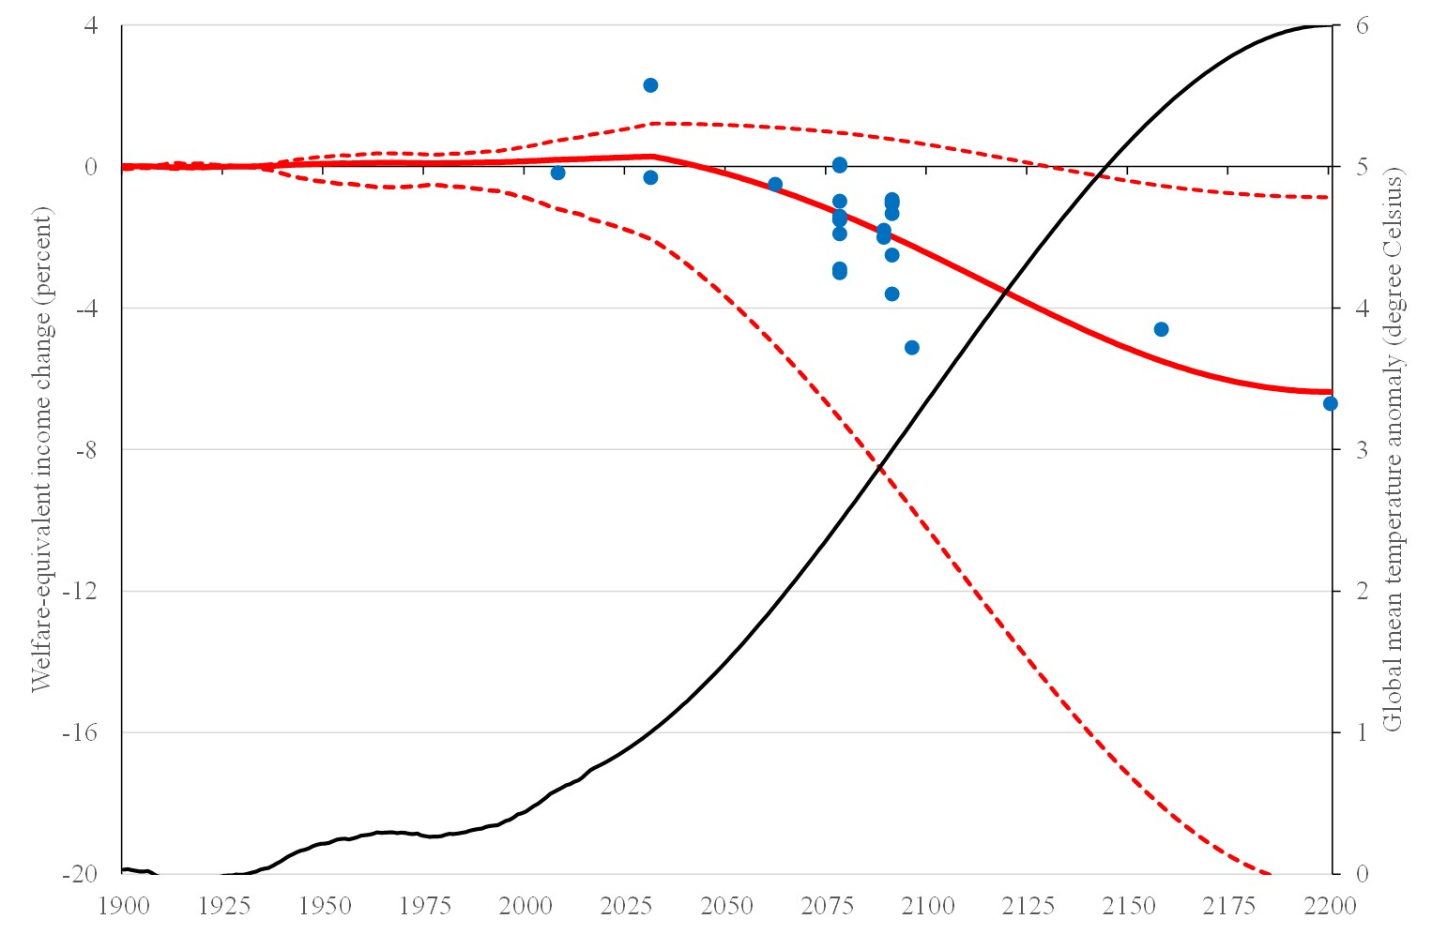

Slide 30
Social cost of carbon
27 estimates of the total impact of climate change, 2789 estimates of its first partial derivative
Proliferation of estimates because
Total impact used to calibrate different impact curves
Different scenarios
Different climate models
Different carbon cycle models
Total impact hides regional, sectoral detail
Different views on how to aggregate over time, space and risk

Slide 31
Current price of emissions permits in EU: ~96 $/tC

Slide 33
Economic Impact
Discussed impacts of climate change on welfare
Benefit of climate policy is the avoided impact
Uncertain, many assumptions
Mix of normative and positive elements

Slide 34
Economic impacts
Methods for estimating total welfare impact
Benefit transfer
Results and caveats
Climate v weather
Social cost of carbon
Distribution of impacts

Slide 36
Exposure
Limits / analogues
Adaptive capacity

Slide 37
Exposure
Limits / analogues
Adaptive capacity

Slide 38
Exposure
Limits / analogues
Adaptive capacity

Slide 39
Adaptive Capacity
Adaptive capacity is the ability to adapt
Adaptive capacity depends on
Available technological options
Available resources & their distribution
Ability and will to use those resources to protect people

Slide 41
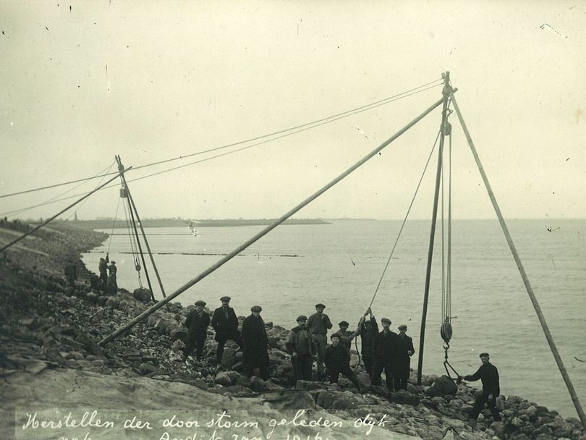
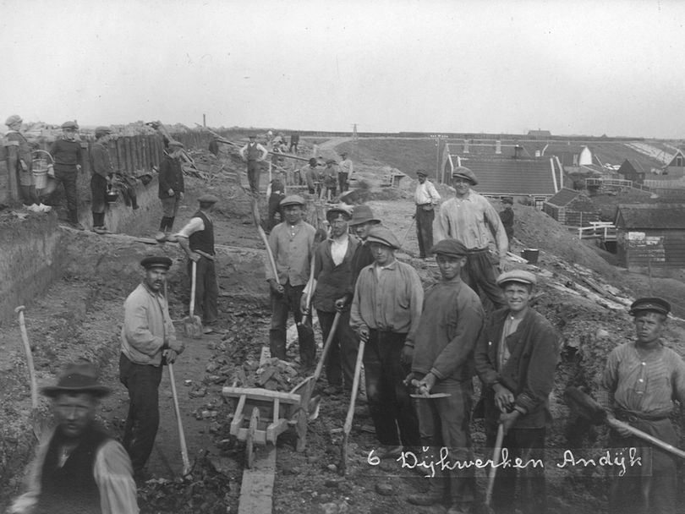
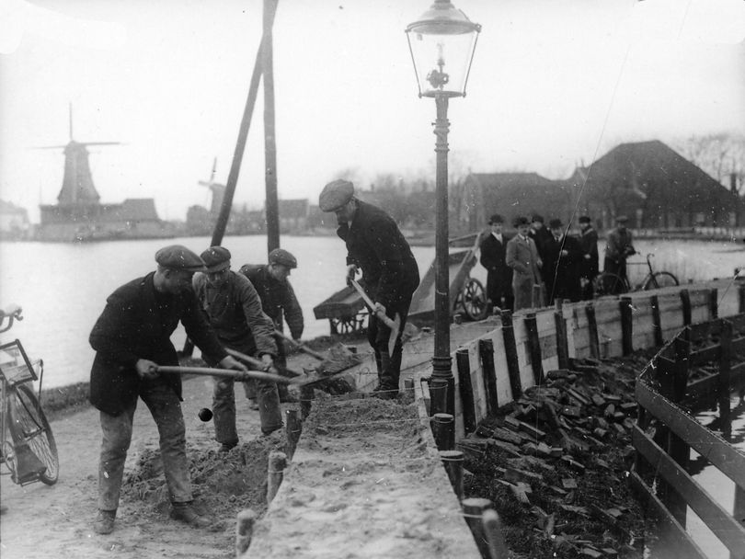
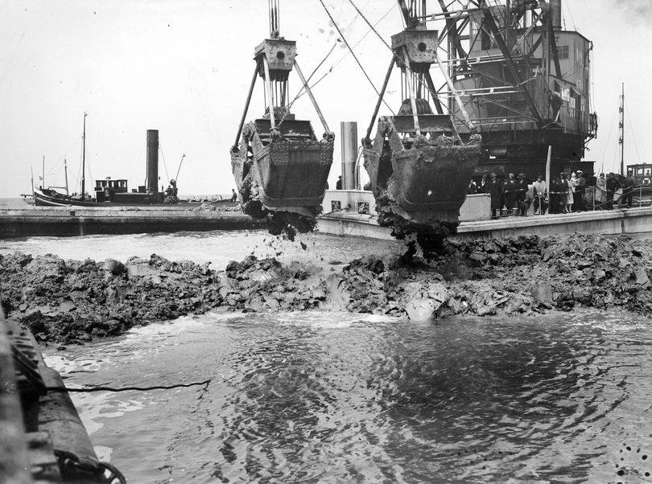
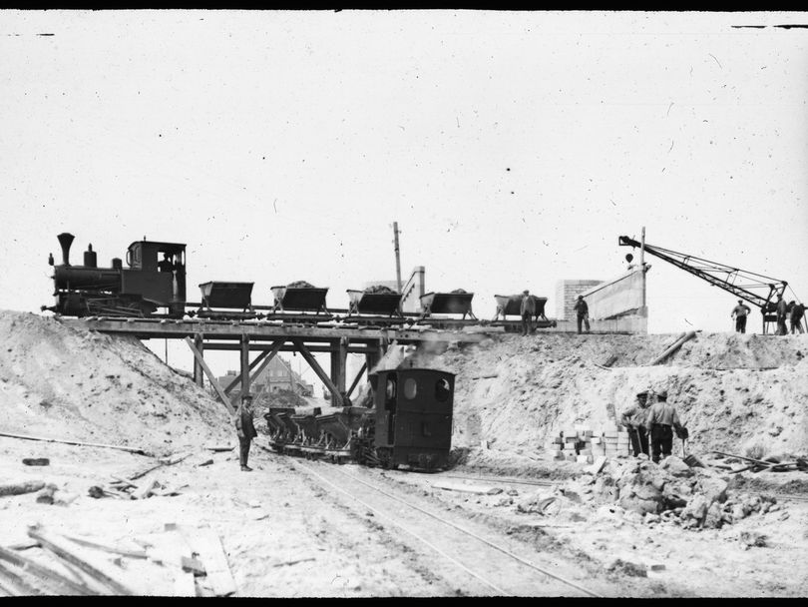
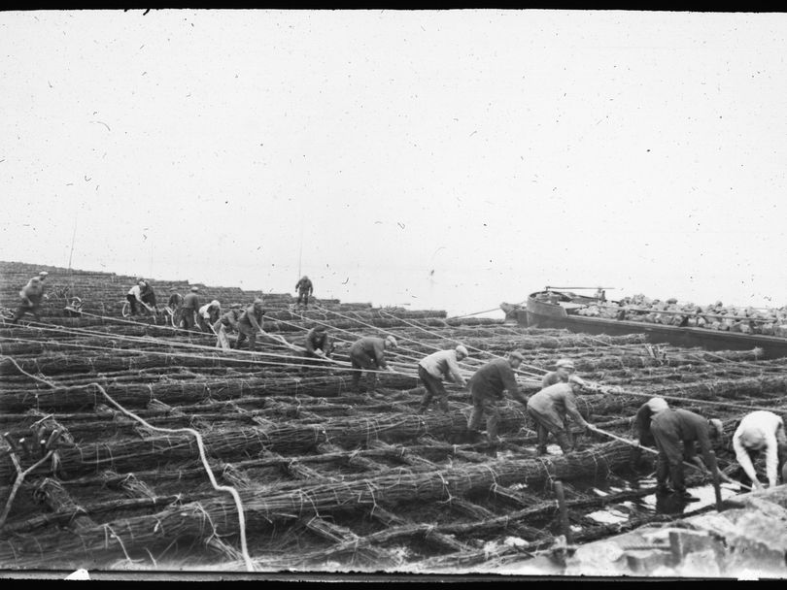
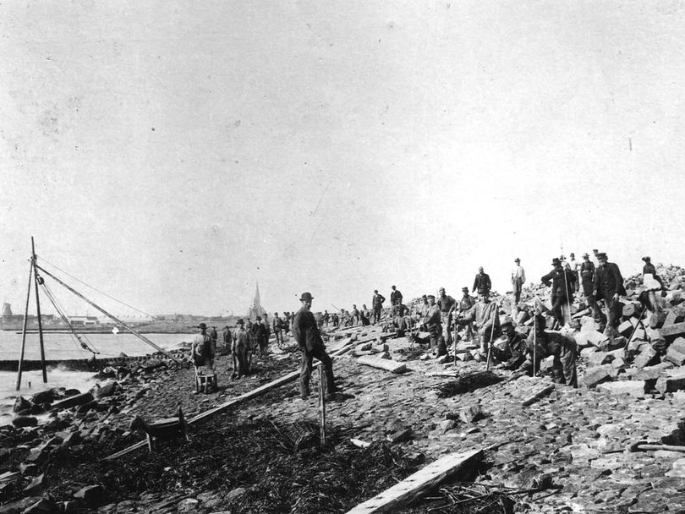

Slide 42
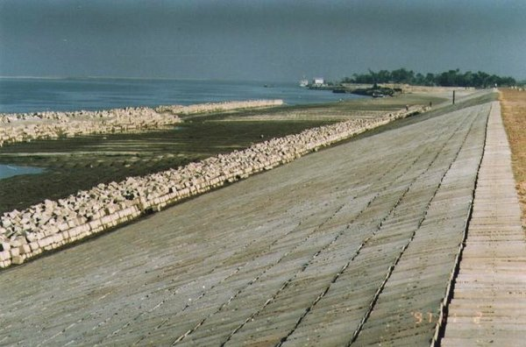
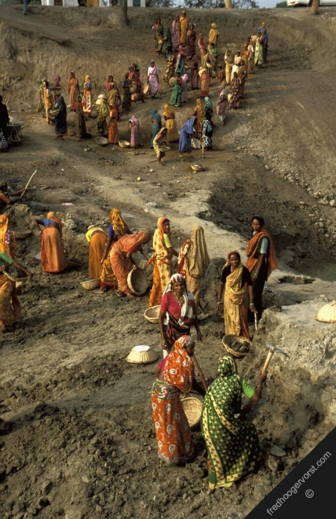
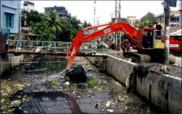
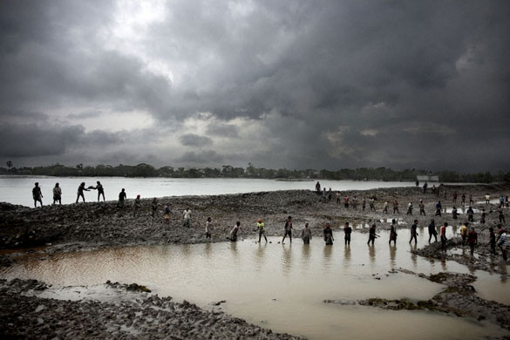
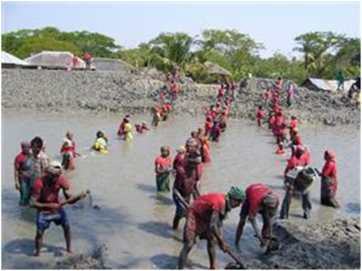

Slide 43
Bangladesh
Economically, Bangladesh is not far behind the Netherlands when it started its flood action plan
Technically, Bangladesh is far ahead
But
Corruption is terrible
Politics is antagonistic
Poor do not carry much weight in decision making
May think floods are a punishment by Allah rather than due to mismanagement by government

Slide 44
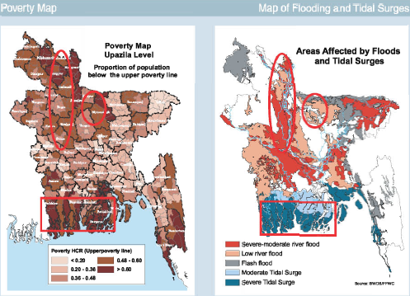

Slide 45
A brief history of the Netherlands
1848 European Spring
1849 Thorbecke Constitution
Central government
Broadly representative of population
1850 Modern dike building starts

Slide 46
